Slide 1
the Advanced Terrestrial Simulator tutorial: Intro
Ethan Coon
LANL-EES
Adam Atchley
Eugene Kikinzon
Dylan Harp
Chonggang Xu
Lucia Short
Terry Miller
LANL-T,CCS
David Moulton
Daniil Svyatsky
Rao Garimella
Markus Berndt
ORNL
Scott Painter
Ahmad Jan
SNL
Alicia Klinvex
Supported by a wide range of funding sources:
NGEE-Arctic, LANL-LDRD, NGEE-Tropics, IDEAS, and more

Slide 2
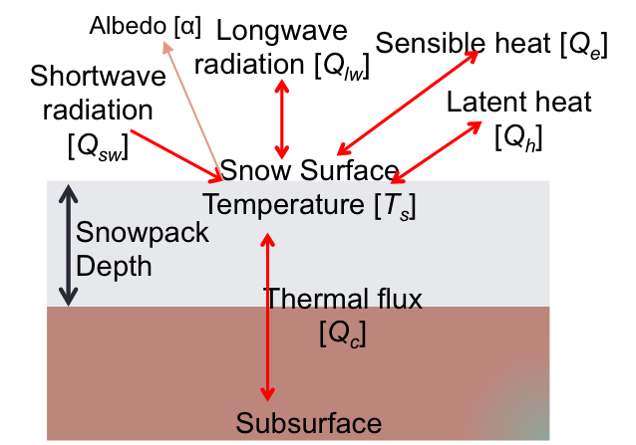
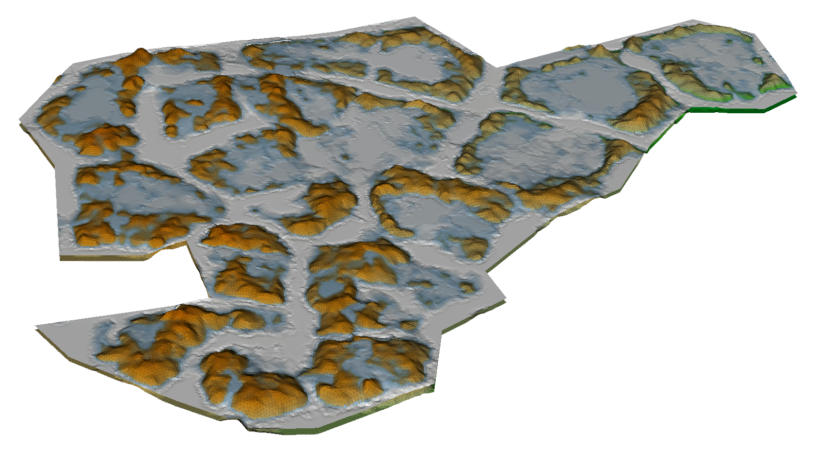
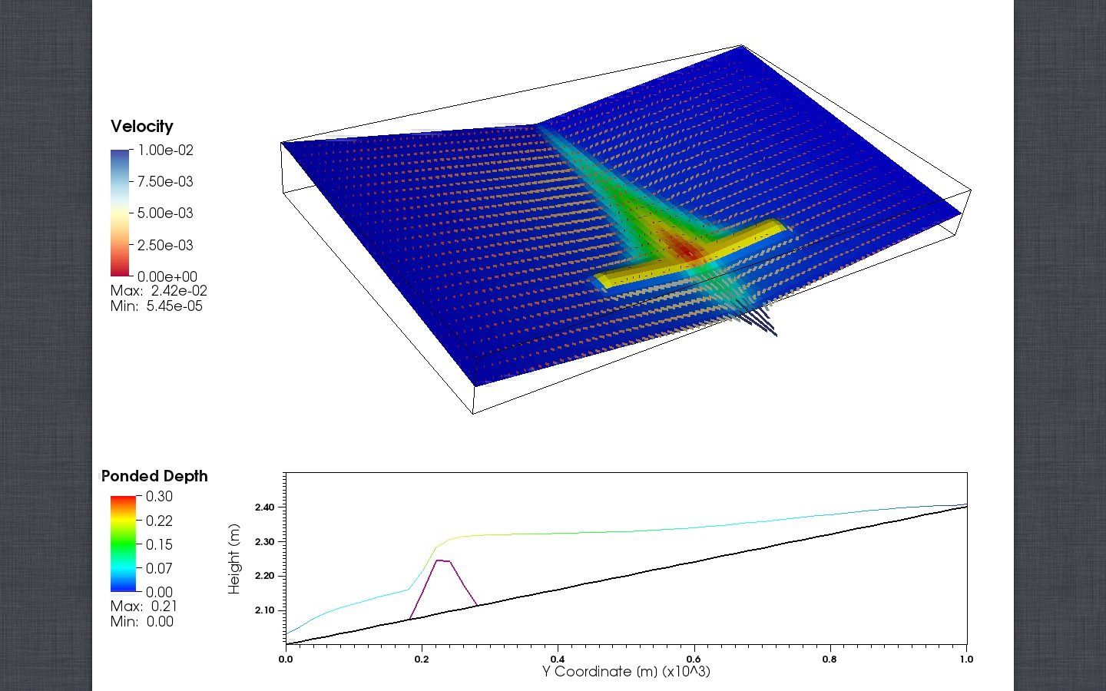
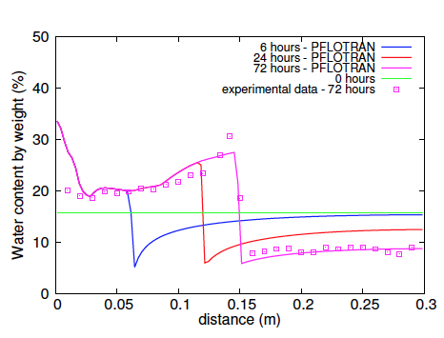
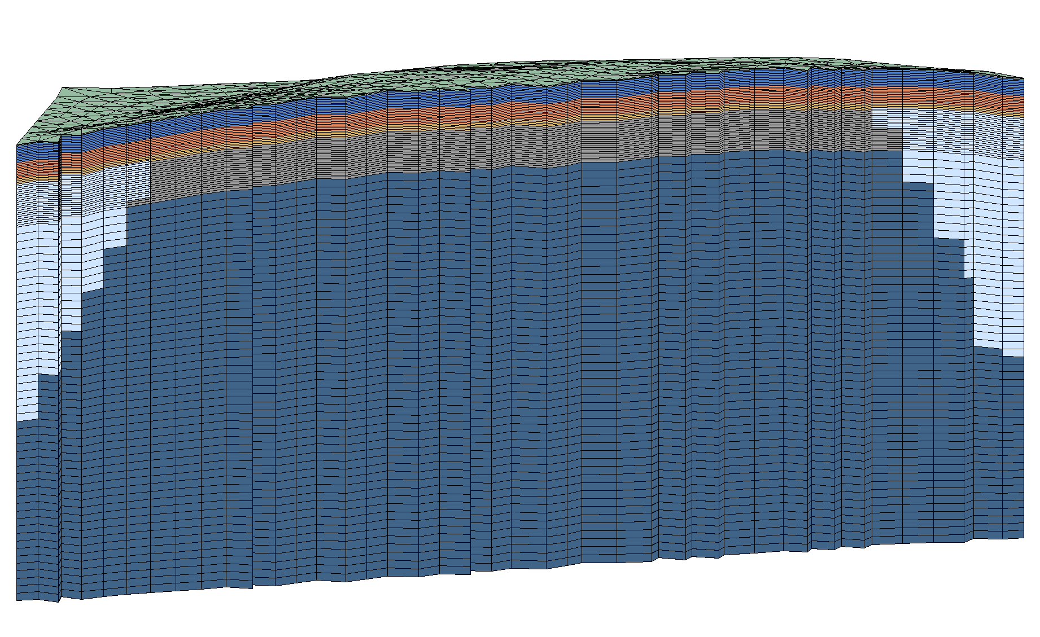
Arctic applications
Mechanistic modeling of physical processes at their native spatial and temporal scales.
surface energy balance
snow distribution
surface flow with energy
meshing workflow
unsaturated, freezing soil
multiphysics framework
Notes:
Process overview, multi-slide: 1. subsurface thermal hydrology, 2. surface hydrology, 3. surface energy balance, 4. snow, 5. met data

Slide 3
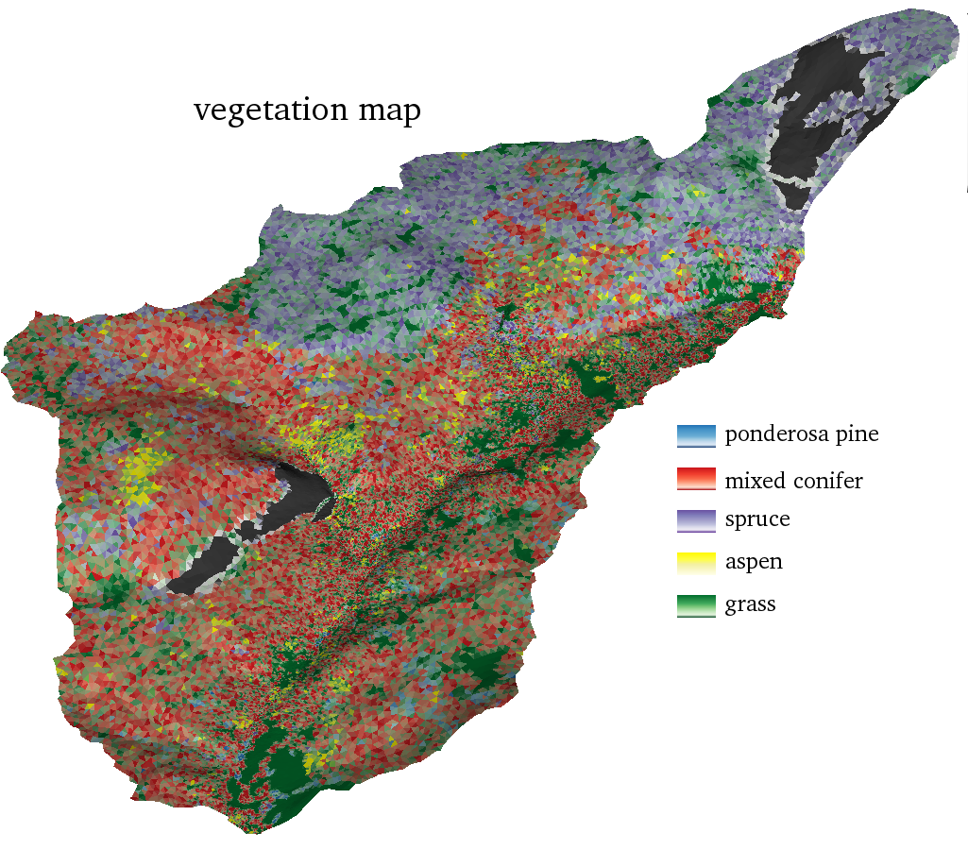
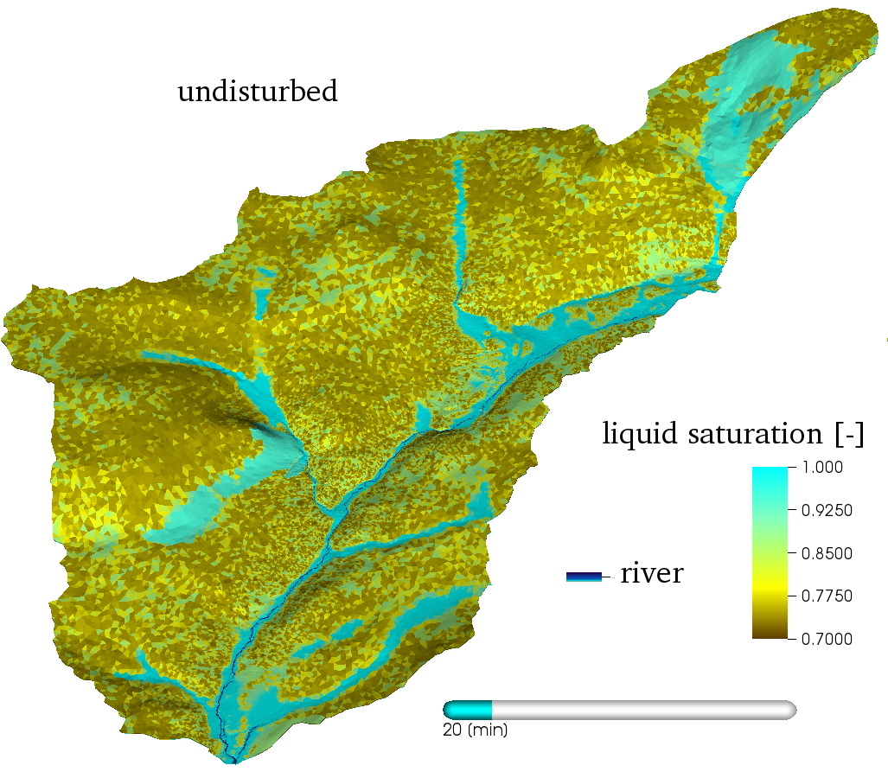
Watershed applications
Mechanistic modeling of physical processes at their native spatial and temporal scales.
Notes:
Process overview, multi-slide: 1. subsurface thermal hydrology, 2. surface hydrology, 3. surface energy balance, 4. snow, 5. met data

Slide 4
Process Representations: Hydrology
Subsurface:
Richards equation
Surface:
Diffusion wave approximation
Coupled through pressure and flux continuity
Add benchmark image, superslab?
Notes:
remove these boxes in favor of boxes like the fire boxes

Slide 5
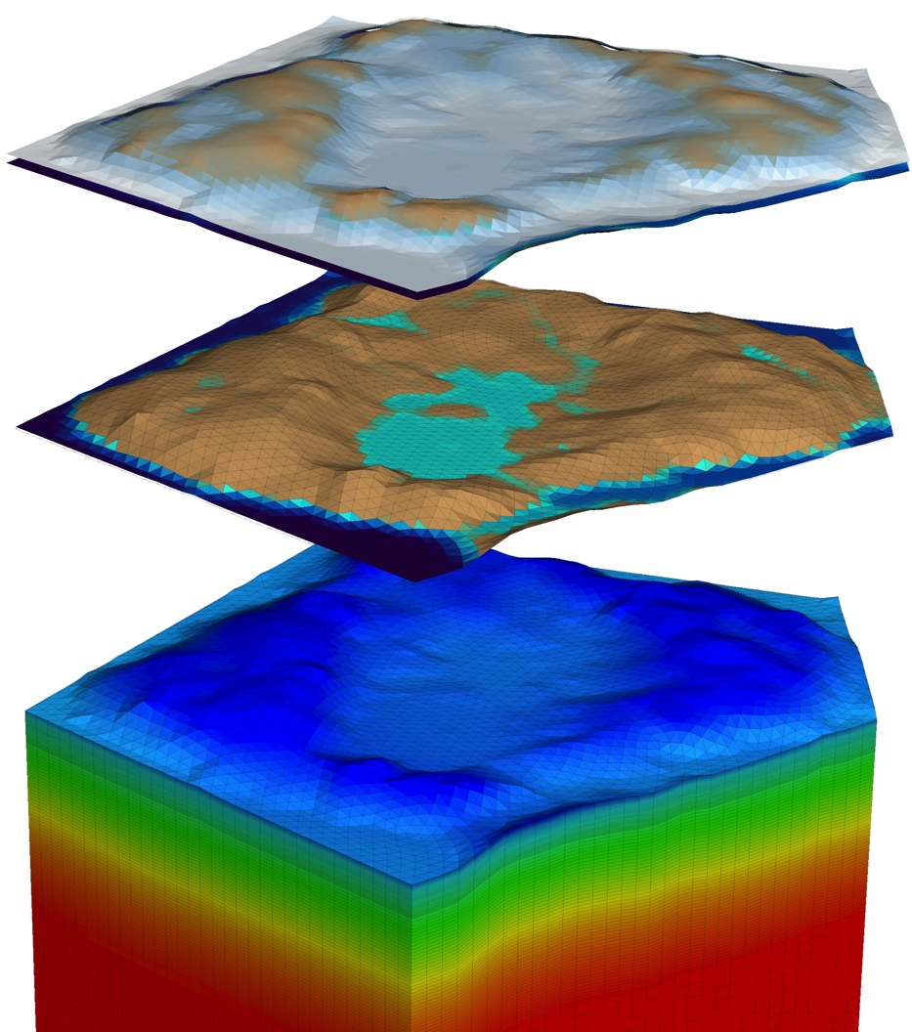
Process Representations: Arctic
Surface Energy Balance:
Latent, sensible heat
including snow/ice
Snow distribution, aging
Subsurface:
3-phase, Richards-like equation
Energy conservation
Freeze/thaw in partially saturated soils: cryosuction, density variations
Limited soil subsidence
Surface water:
Freeze/thaw of ponded water
Notes:
remove these boxes in favor of boxes like the fire boxes

Slide 6
Process Representations: disturbance
Canopy:
interception
shading (evaporation)
transpiration
litter production
Litter, grass:
interception
shading (evaporation)
surface roughness
protection from raindrop impact
duff production
Duff:
high porosity, high permeability (effects infiltration and storage)
Soil:
soil compaction (raindrop impact and/or pore-filling)
hydrophobicity
erosion

Slide 7
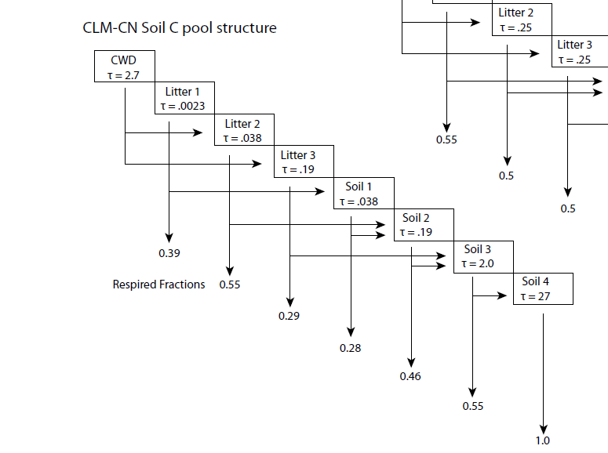
Process Representations: BGC
Dynamic, PFT-based vegetation, multi-leaf layer model similar to CLM4.5
Currently limited to a few PFTs but easily expanded
Century model for subsurface carbon cycle

Slide 8
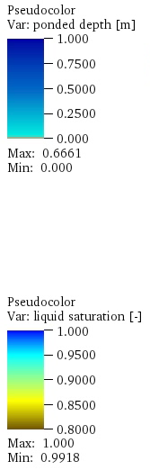
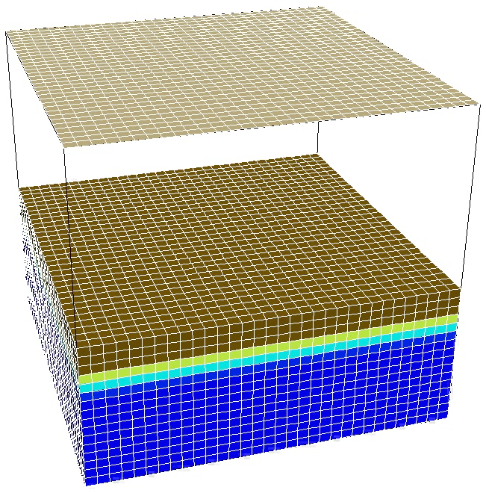
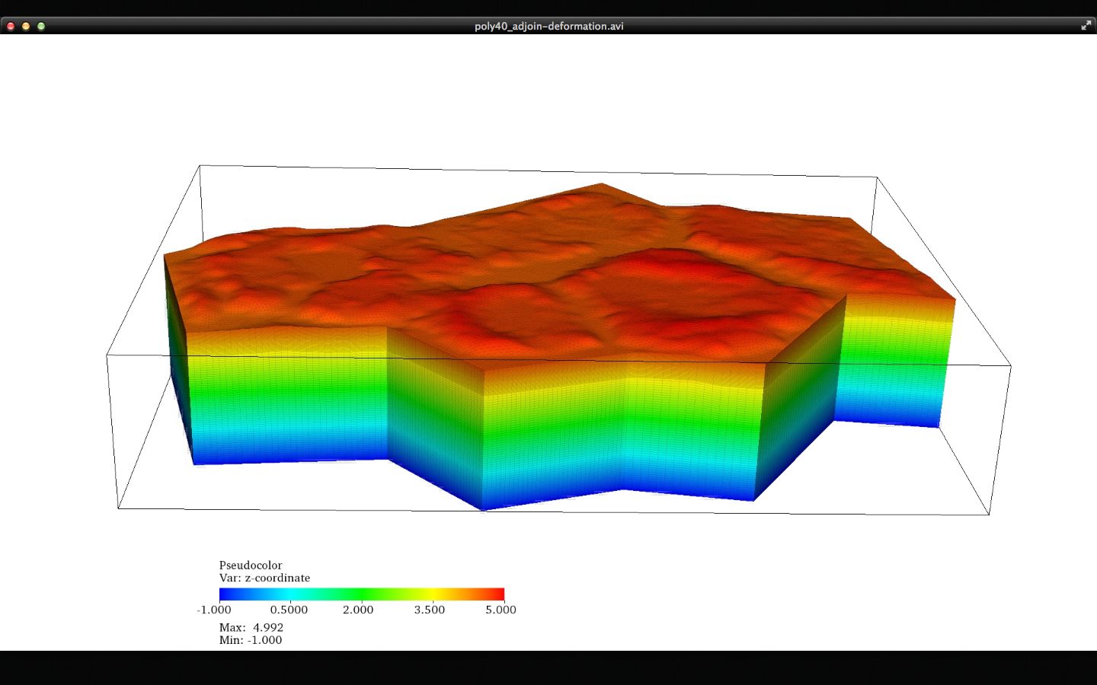
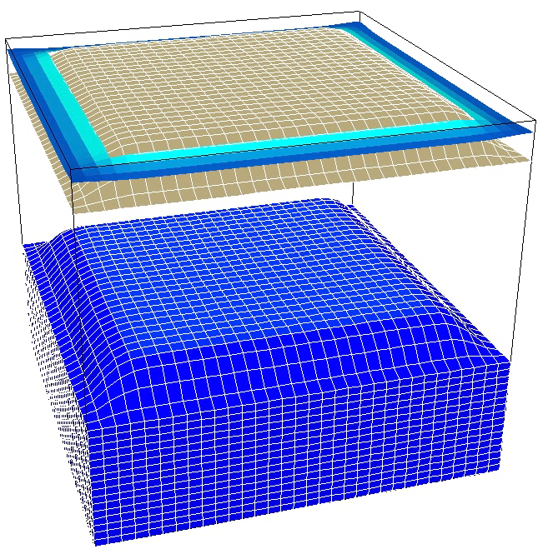
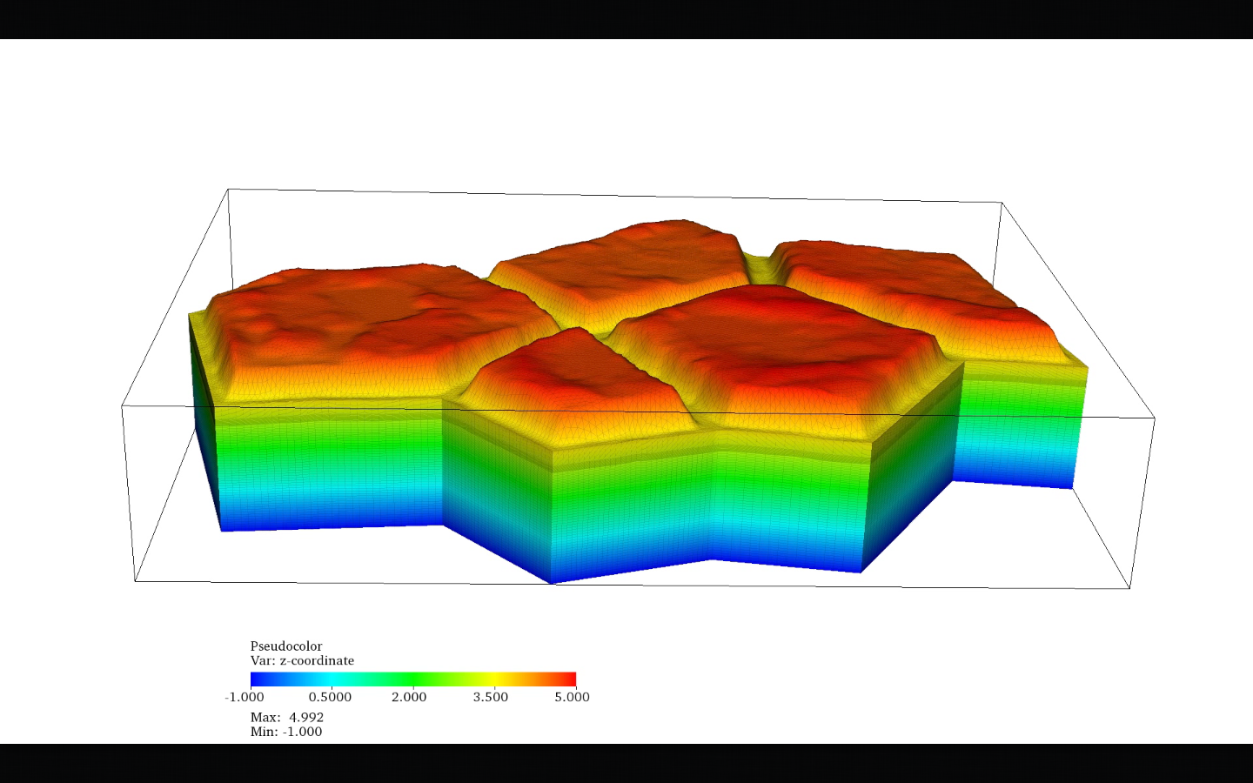
Process Representations: deformation
Limited deformation capabilities.
Deformable meshes.
Working examples coupling vertical deformation and water.

